Slide 1
MOVIE RECOMMENDATION SYSTEM USING APACHE SPARK
Presented By:
Desai Vrushali 1304029
Nerlekar Rohan 1204026
Mote Avadhut 1304040
Vanjari Rushikesh 1104054
Rananvare Harshada 1304041
Under the Guidance of:
Prof. Mr. S.S.Howal

Slide 2
Index
Introduction
Problem Definition
Problem formulation
Problem solution
Result Analysis
Installation of Hadoop spark and scala
Reference
Conclusion

Slide 3
Introduction
Recommender systems are an important part of the informative websites, commercial websites and e-commerce system.
Recommender system plays an important role in the social media like Facebook, Twitter, YouTube etc.
Movie recommendation system aims to provide the best movie recommendation using the past data where in algorithms are used to evaluate the results .
They represent a powerful method for enabling users to filter through large information and product spaces.
Effective deployments must begin with careful analysis of prospective users and their goals. Specific tasks, information needs, and item domains represent unique problems for recommenders

Slide 4
Problem Definition
21st century-lead to overgrowth of data.
Which movie should I watch next?
Which book should I read?
Which link should I click next?
We all are inundated with such questions all the times.
This decision making process has especially become serious in today’s world as people can find everything on Internet.
Recommendation systems are used to suggest information products and services to the regular customers based on the history, transactions and feedback.
In the growing field of Big-data, the number of products, customers and provider are increasing tremendously.
Hence recommendation system become need and a growing challenge to produce results

Slide 5
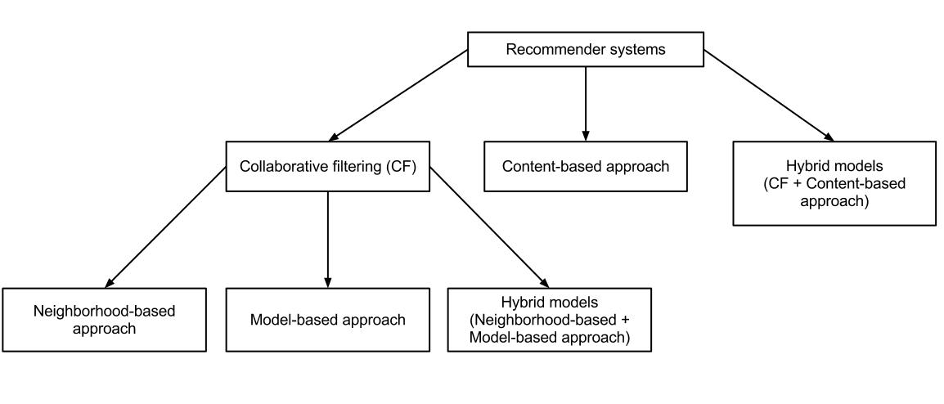
Recommender System Architecture

Slide 6
Problem Formulation:
Movie recommendation can be defined as given an Movie under consideration, present recommend similar entities.
Given the large number of related entities in the knowledge base, we need to select the most relevant ones to show based on the current query of the user.
Input: An Movie
Output: Recommended entities given the input Movie
Data: semi structured or unstructured data
Movie: represent an object, structured data

Slide 7
Proposed Solution
Problem is to provide a solution to build a recommendation engine using Big Data handling technology, using data processing tool Apache Spark.
The goal of an Movie recommendation system over big data is to design a system that is scalable, efficient, and provides the best possible results for a large variety of queries.

Slide 8
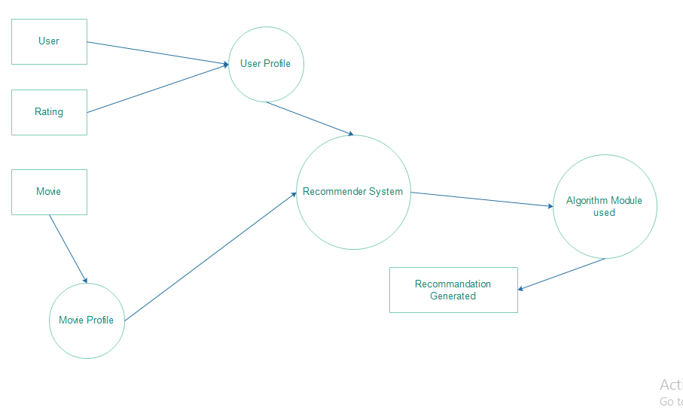
DFD

Slide 9
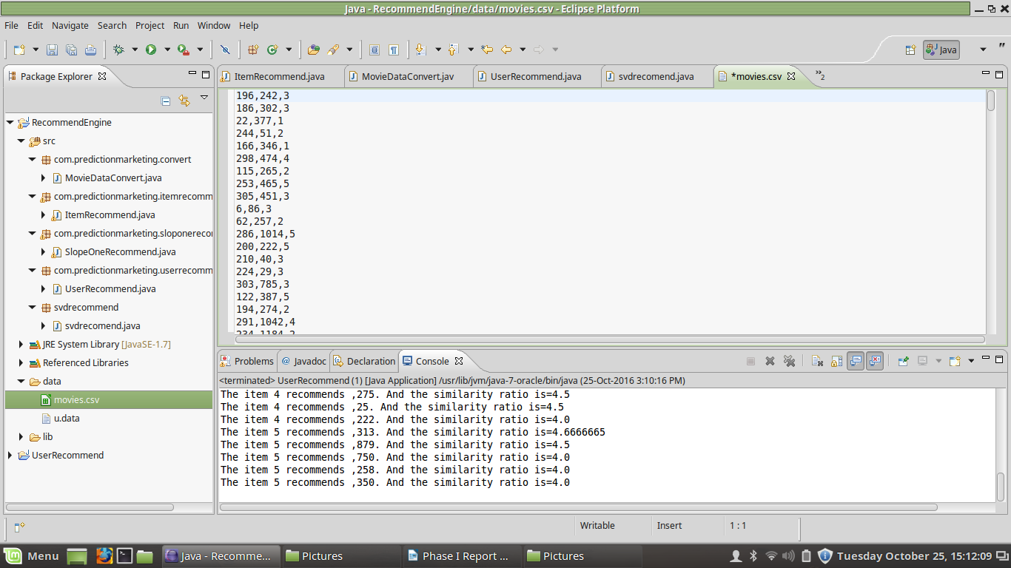
Development (Implementation & Installation)
Screenshots of Implementation :converting asymmetrical dataset into symmetrical

Slide 10
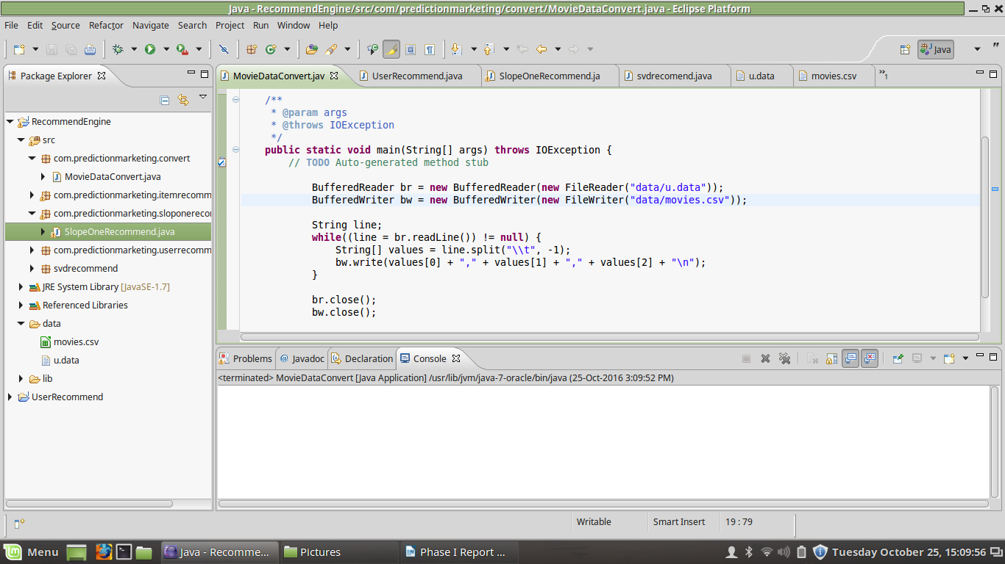
Code of converting data

Slide 11
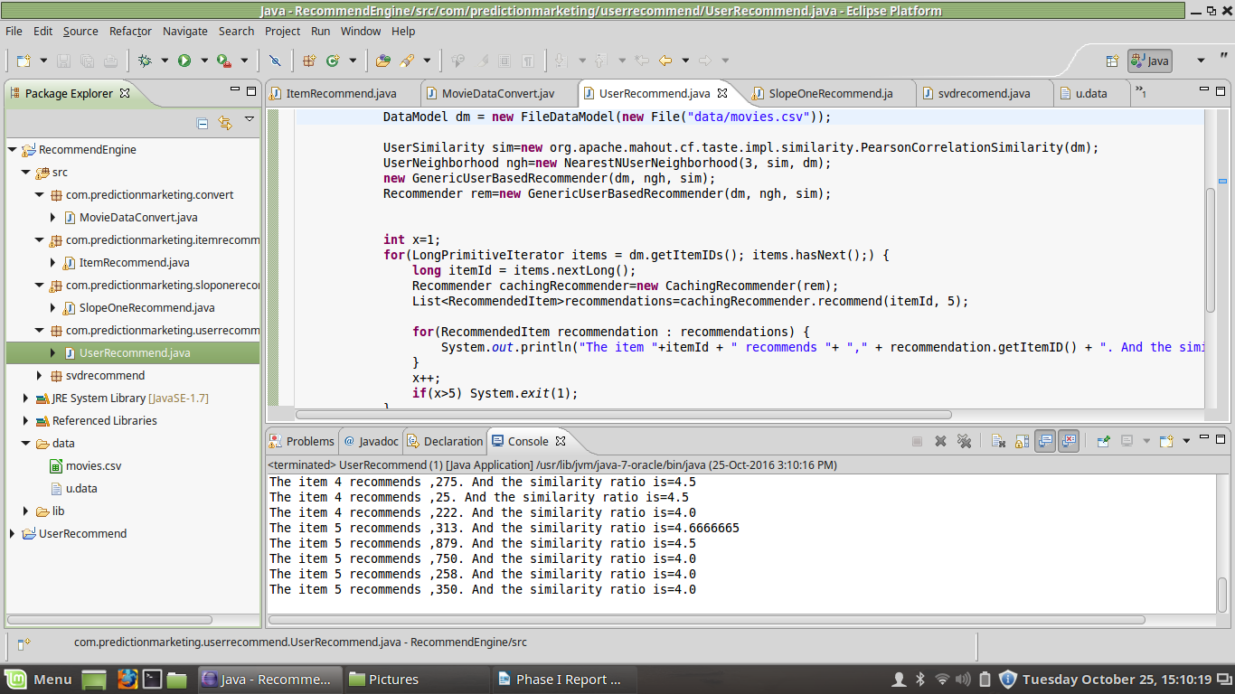
User recommendation & o/p

Slide 12
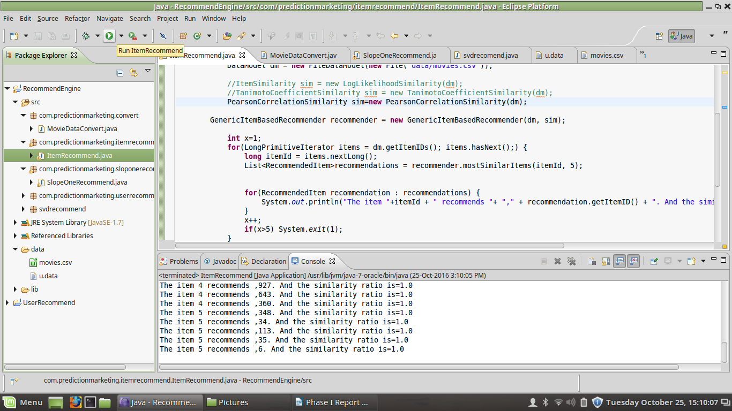
Item, Tanimoto, Pearson Recommendation & o/p

Slide 13
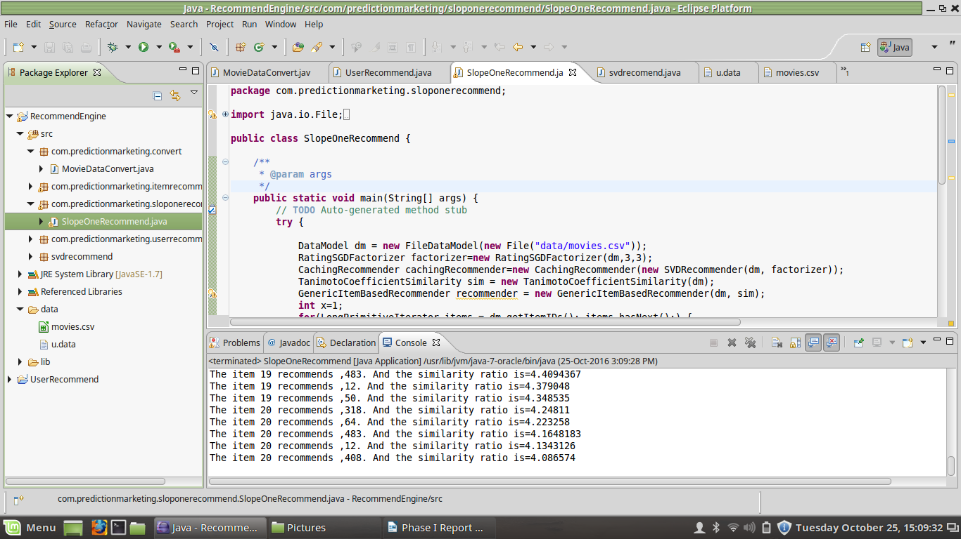
Slope one Recommendation & o/p

Slide 14
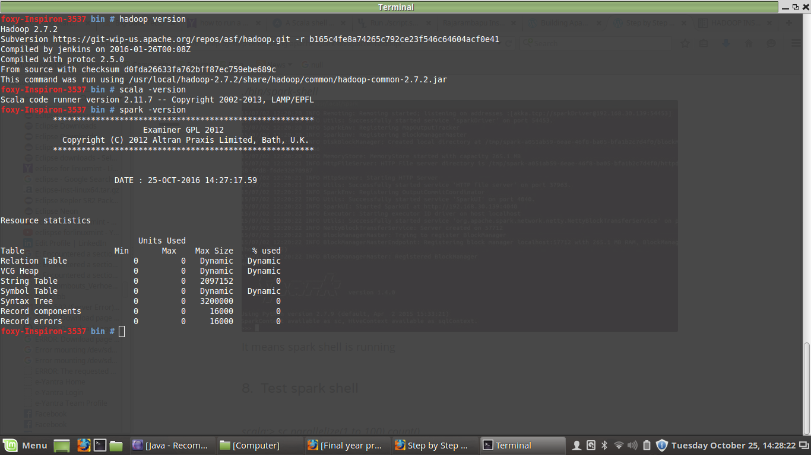
Installation of hadoop, scala, apache spark.

Slide 15
Development (Implementation & Installation) using Python in Anaconda.

Slide 16
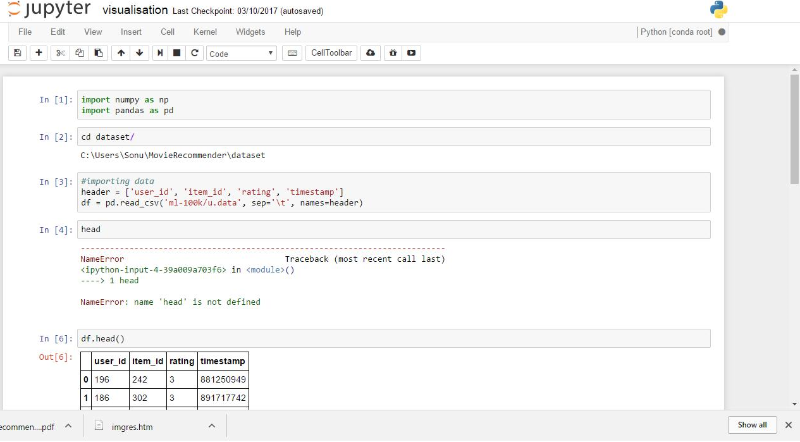
This screenshot shows the program that imports python libraries and takes input CSV file which is nothing but dataset and gives column names to it.

Slide 17
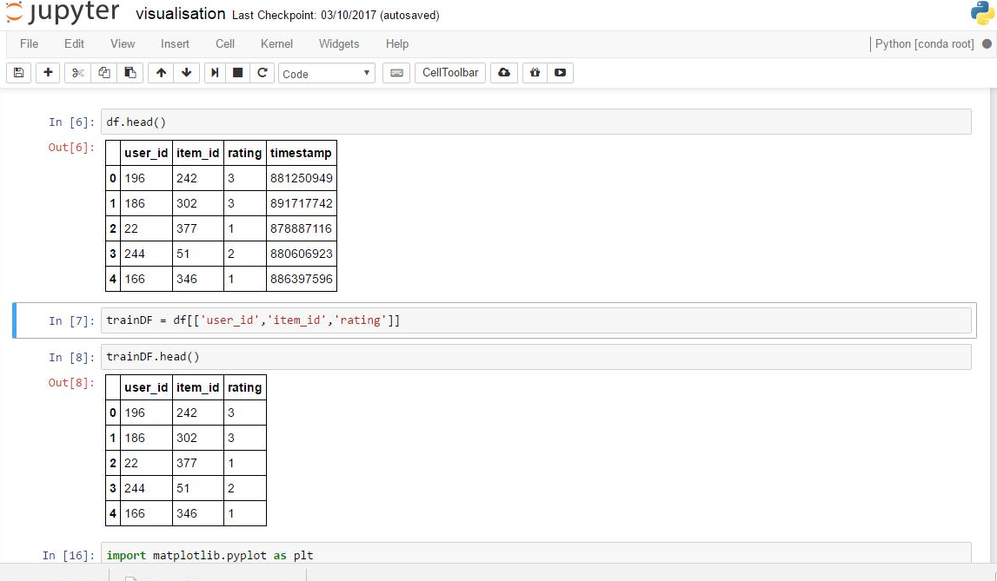
This screenshot shows the program that converts the dataset from asymmetric to symmetric i.e. it deletes the last column and trains the dataset.

Slide 18
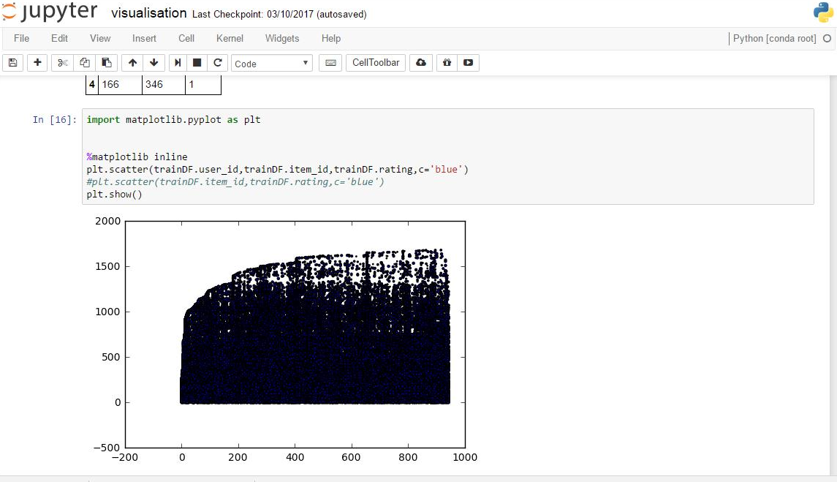
This screenshot shows the program that visualizes the converted the dataset from asymmetric to symmetric.

Slide 19
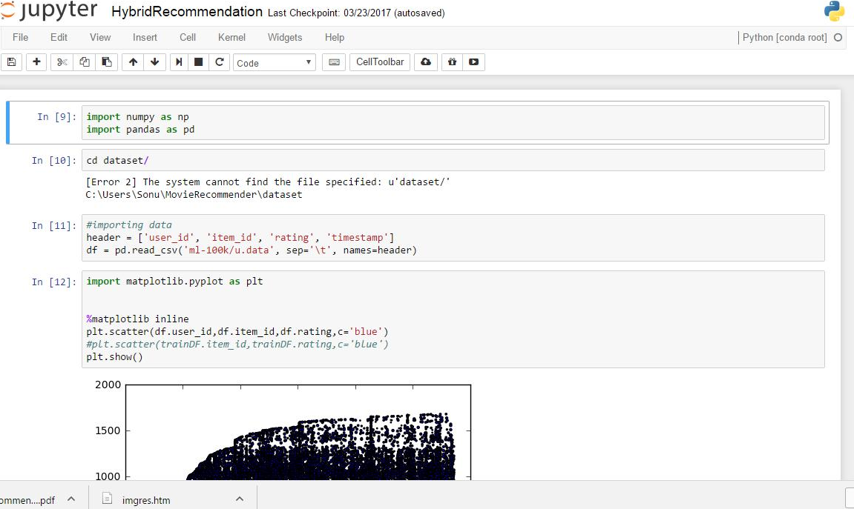
Input database:

Slide 20
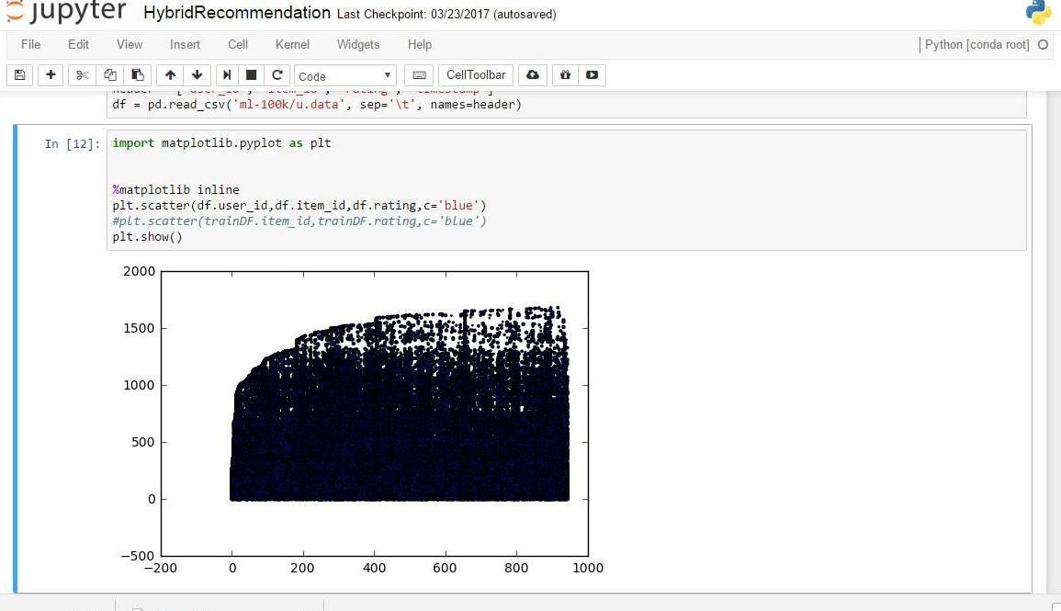
This screenshot shows the program that imports python libraries and visualizes the dataset before applying the hybrid algorithm

Slide 21
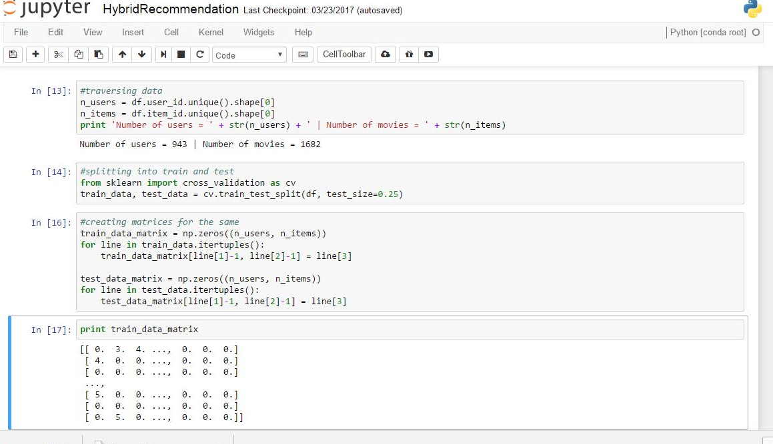
This screenshot shows the program that imports python libraries and traverses the dataset and shows the result. After traversing the dataset it splits the dataset into test data and train data matrix to perform the testing of hybrid algorithm on the same.

Slide 22
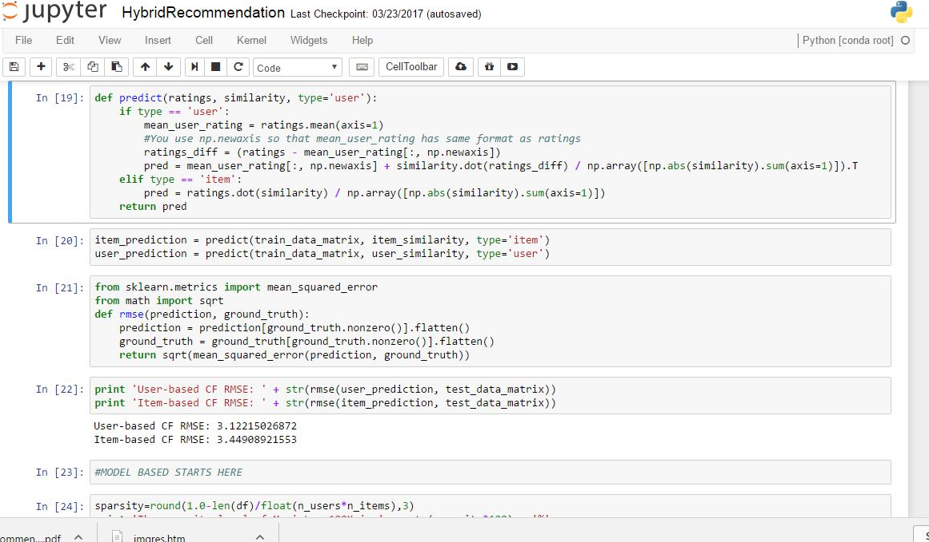
This screenshot shows the program that imports python libraries, defines functions and uses collaborative filtering algorithm for prediction of recommendations and calculates root mean square error value of both user and item prediction.

Slide 23
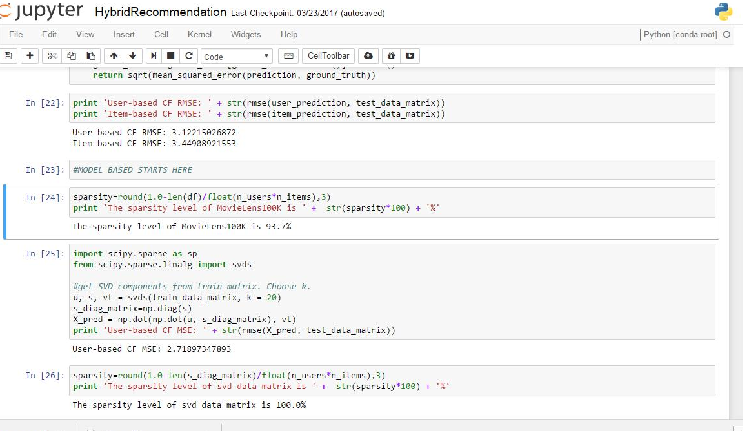
This screenshot shows the program that imports python libraries, defines functions and uses content based SVD algorithm for prediction of recommendations and calculates root mean square error value and sparsity.

Slide 24
Development (Implementation & Installation) using Scala in Apache Spark

Slide 25
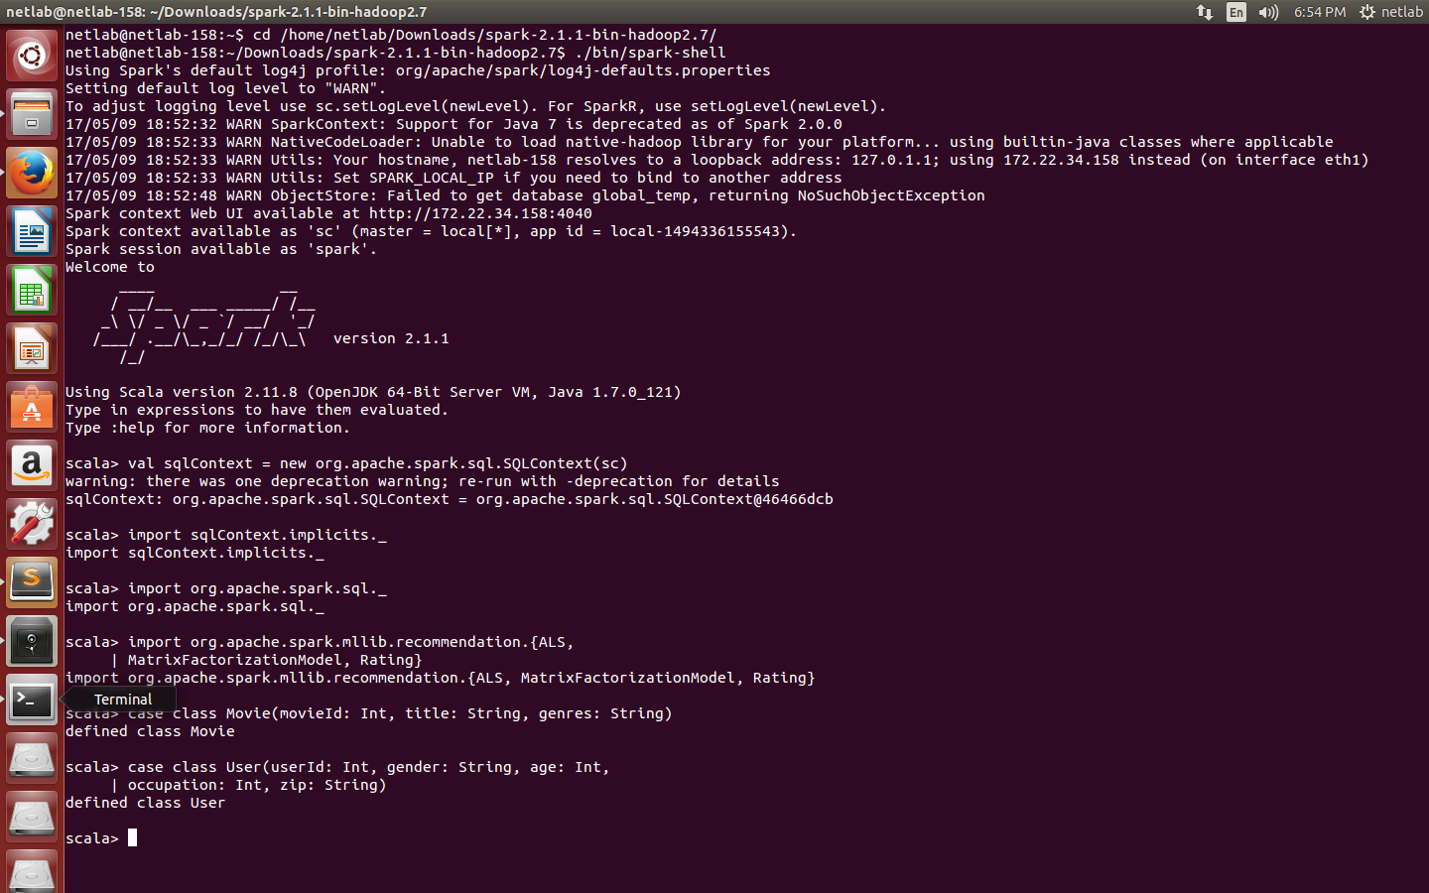
Installation of Spark is completed

Slide 26
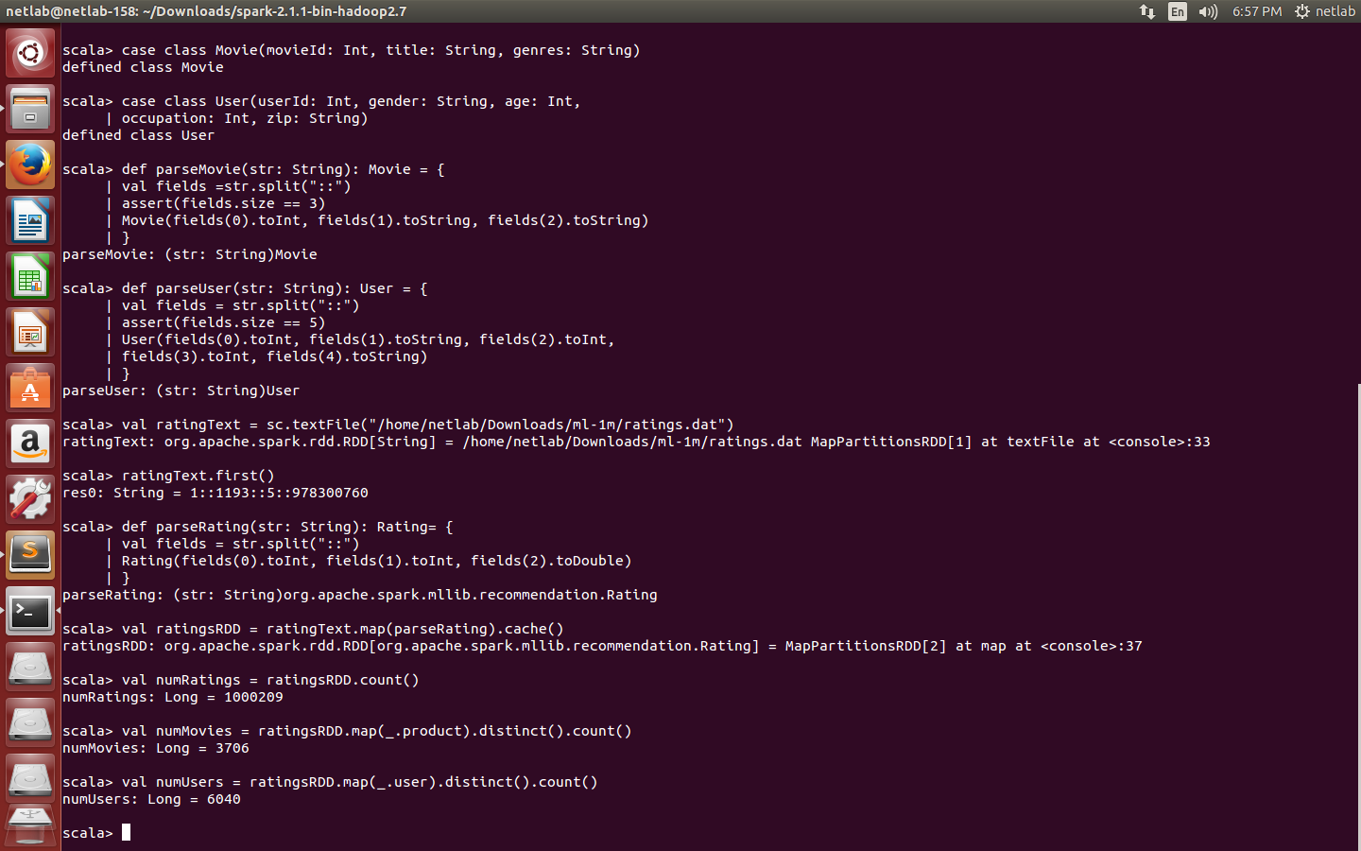
Below we use Scala case classes to define the Movie and User schemas corresponding to the movies.dat and users.dat files.

Slide 27
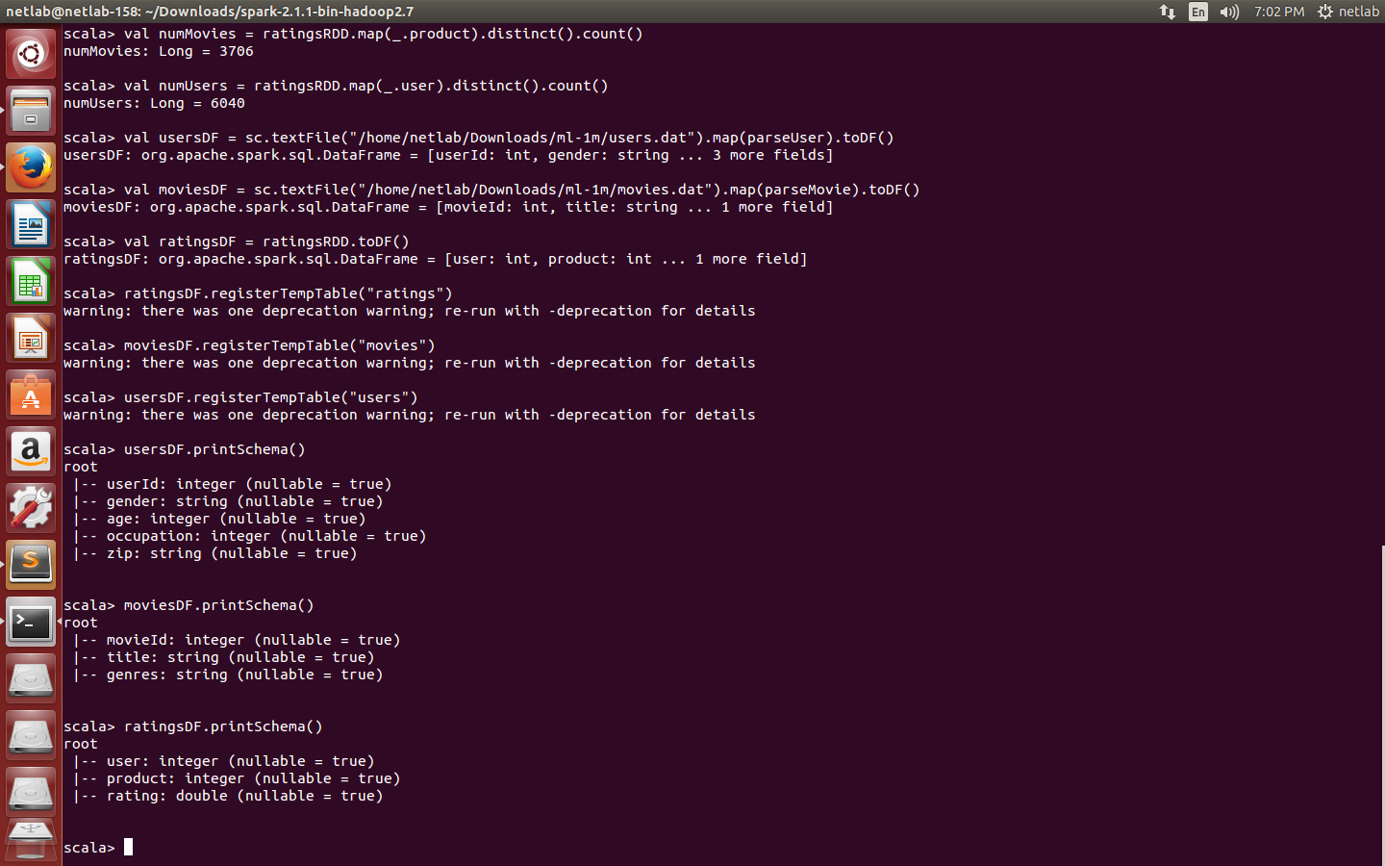
DataFrame printSchema() prints the schema to the console in a tree format.

Slide 28
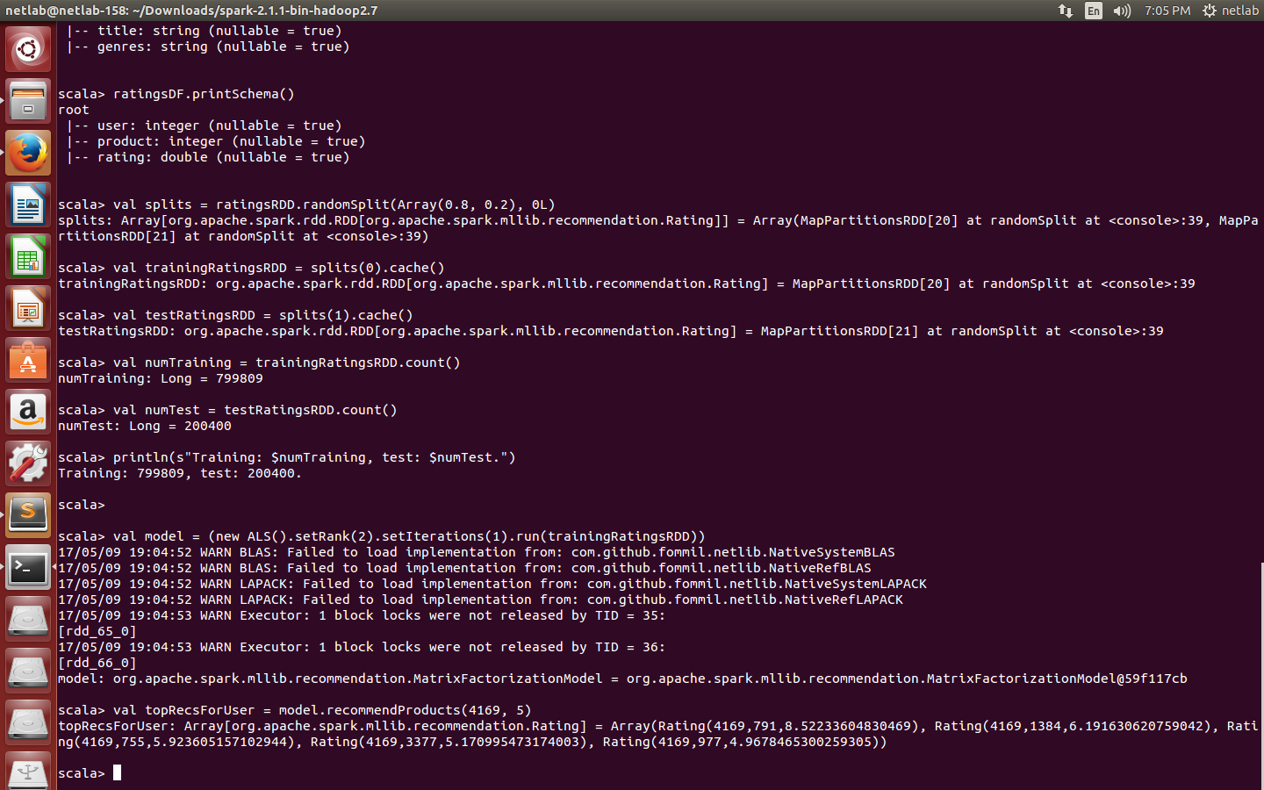
Using ALS and movie rated data: Make Prediction

Slide 29
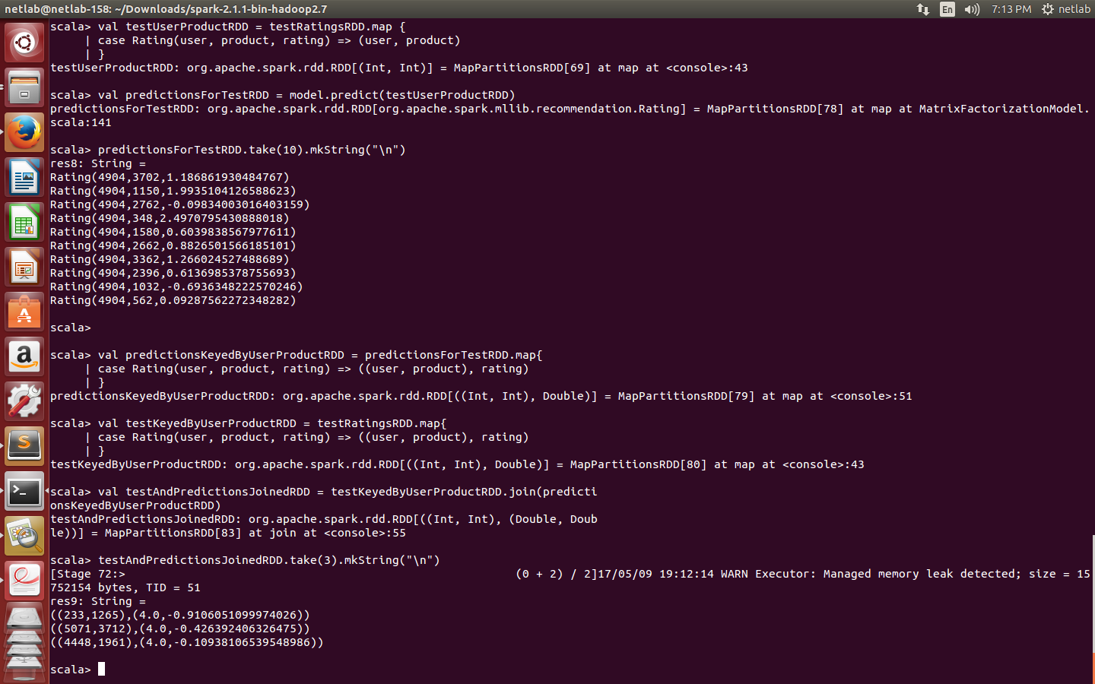
Predictions:

Slide 30
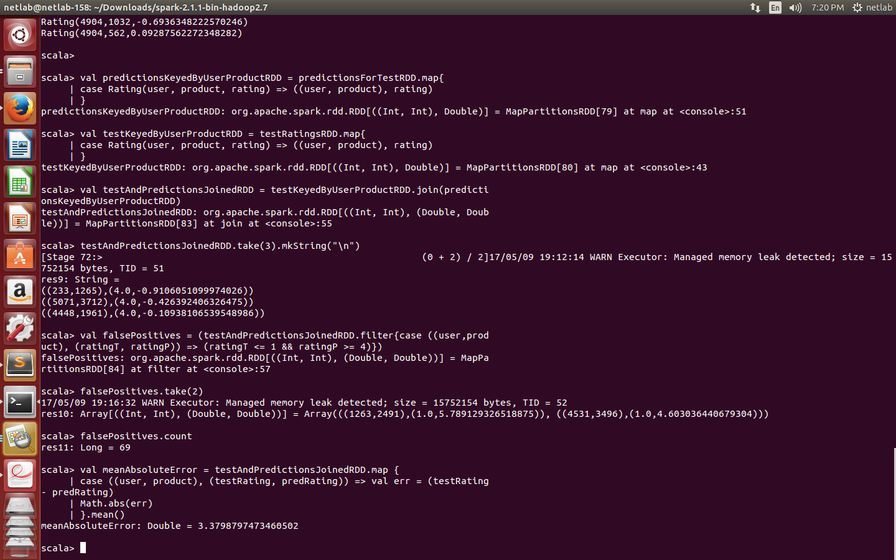
Mean Absolute Error (MAE).

Slide 31
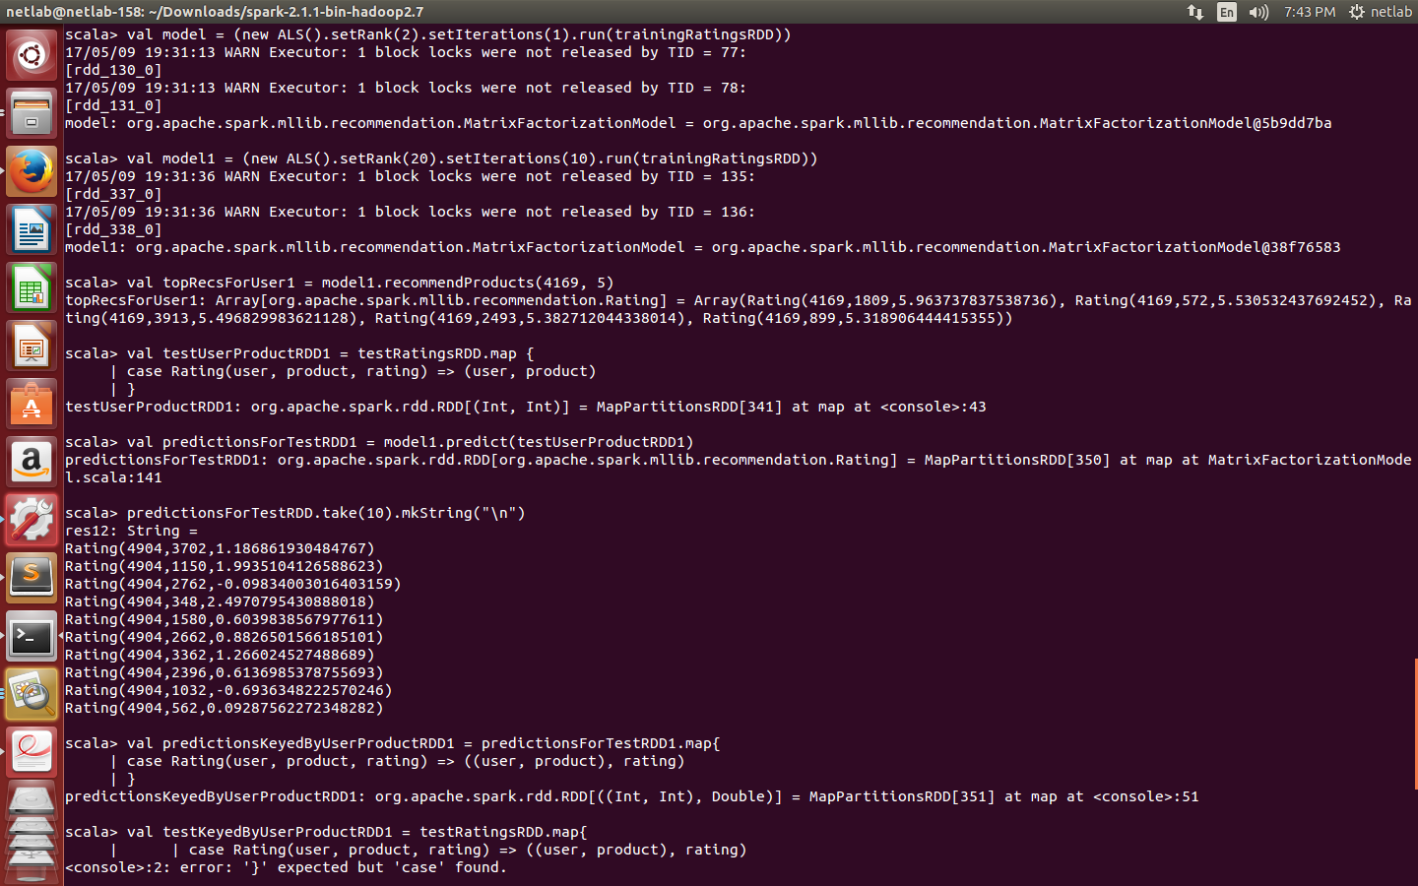

Slide 32
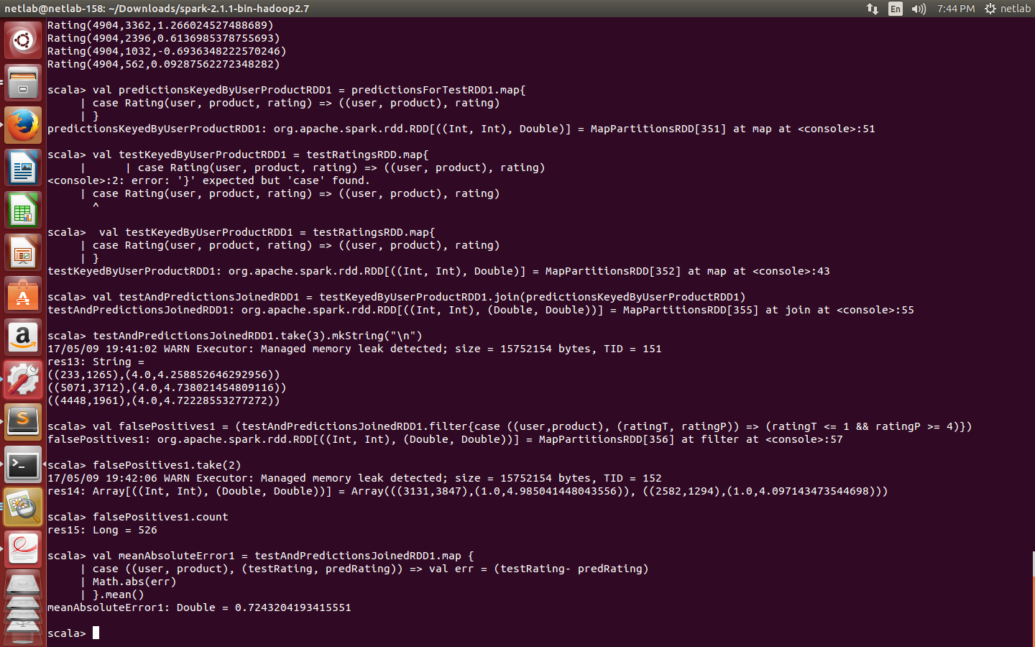

Slide 33
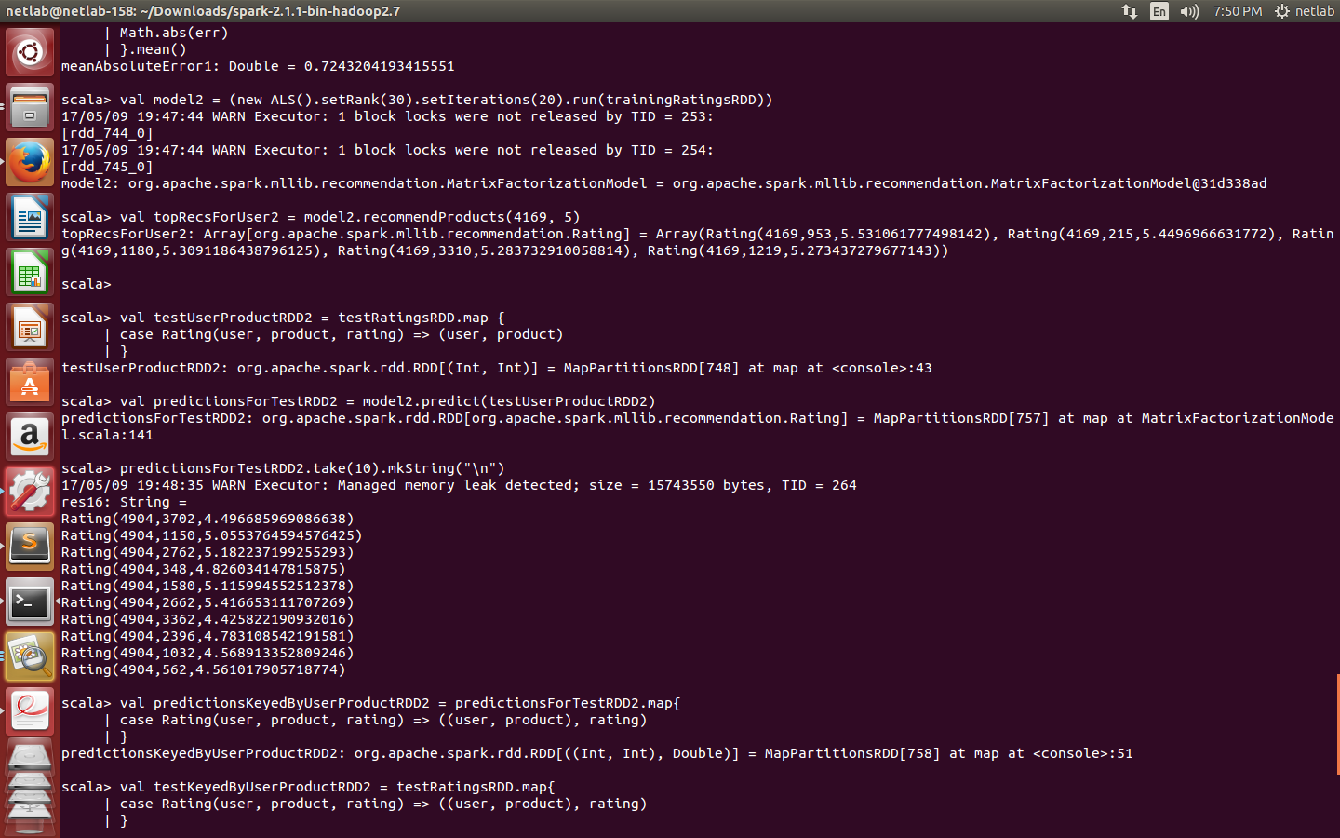

Slide 34
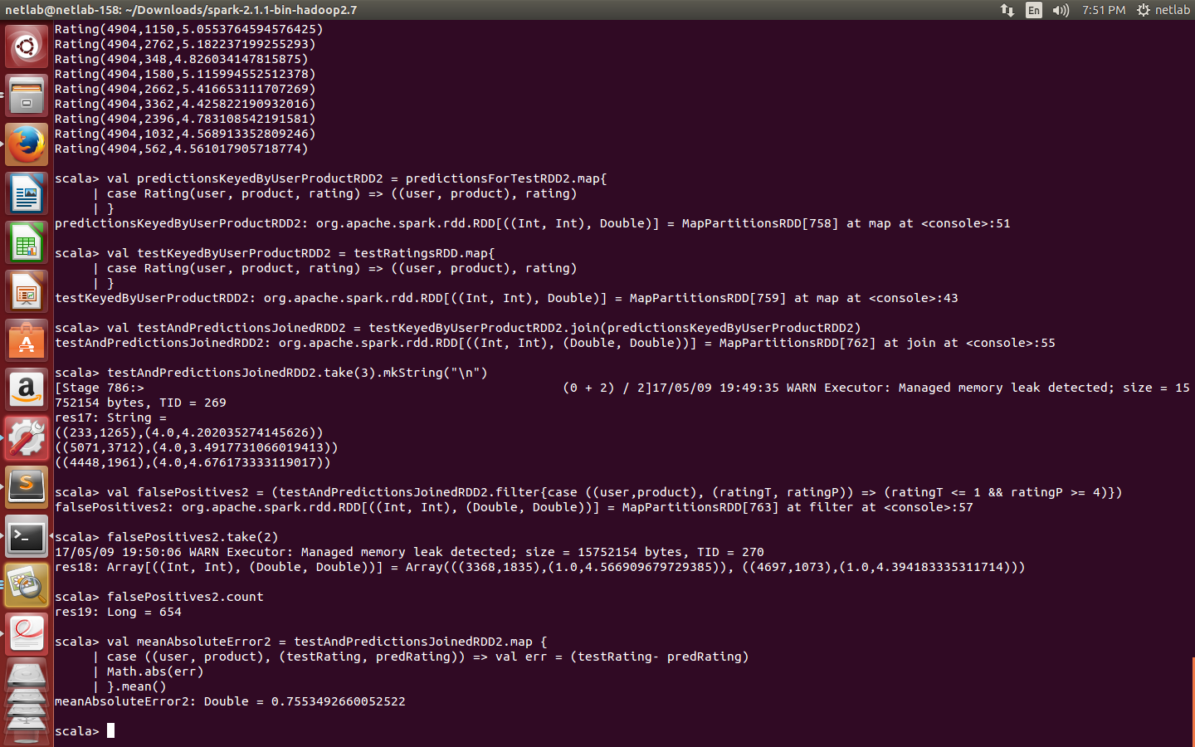

Slide 35
Conclusion:
We successfully implemented basic algorithms in java, using eclipse & mahout libraries. The implemented algorithms are: item-item, user-user similarity, tanimoto, Pearson coefficient, Slope one, SVD recommendation.
We have successfully installed the softwares which are needed for Recommendation System viz Hadoop, Scala, SBT and Apache Spark and practiced basic programs of each.
We studied and filtered Collaborative filtering algorithms and chose the three algorithms which gave best results for implementation. The algorithms are Pearson coefficient algorithm and SVD algorithm.
Further implementation of modules is under work.

Slide 36
References
[1]Ungar LH, Foster DP. “Clustering methods for collaborative filtering”. In AAAI workshop on recommendation systems (Vol. 1, pp.
114-129), Jul 26 1998
[2]Scala. http://www.scala-lang.org
[3] Apache Hive. http://hadoop.apache.org/hive
[4] http://grouplens.org/datasets/movielens/
[5]Ungar LH, Foster DP. “Clustering methods for collaborative filtering”. In AAAI workshop on recommendation systems (Vol. 1, pp.114-129), Jul 26 1998
[6]J. Jiang, J. Lu, G. Zhang, and G. Long, “Scaling-up item-based collaborative filtering recommendation algorithm based onhadoop,” in Services (SERVICES), 2011 IEEE World Congress on. IEEE, 2011,pp. 490–497.
[7]Adomavicius, Gediminas, and Alexander Tuzhilin. "Toward the next generation of recommender systems: A survey of the state-of-the-art and possible extensions." Knowledge and Data Engineering, IEEE Transactions on 17.6 (2005): 734-749.

Slide 37
Thank You

